Slide 1


CITS1003 Introduction to Cybersecurity [3] Introduction to Computers and Networks exercises
Dr Zhi Zhang

Slide 2
Sniffing
Remote shell
Lecture and Lab in Week 2

Slide 3
Sniffing
Sniffing is a passive attack
What is it: capture network traffic between two communicating nodes
Detection: hard to detect such attacks, as the attack does not leave any traces in the network.
Prevention: can be prevented via encryption

Slide 4


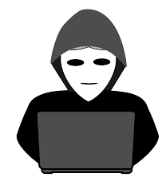
Sniffing
Establishing a secure channel to communicate is important
Insecure Channel
Alice
Bob
Eavesdropper

Slide 5
Sniffing
Establishing a secure channel to communicate is important
It is also critical to consider the coverage of the channel
Secure Channel
Alice
Bob
Eavesdropper

Slide 6
Sniffing
Establishing a secure channel to communicate is important
It is also critical to consider the coverage of the channel
Insecure Channel
Gateway
Secure Channel
Gateway
sniffing
Alice
Eavesdropper
Private Company
Bob

Slide 7
Insecure channel is not encrypted, e.g., http
Secure channel is encrypted, e.g., https
Google Chrome notifies users that http is no longer secure
https://security.googleblog.com/2018/02/a-secure-web-is-here-to-stay.html

Slide 8
Why is https secure?
SSL/TLS protocol
SSL: Secure Socket Layer
TLS: Transport Layer Security
Is https secure enough?
See the case study in lab 4

Slide 9
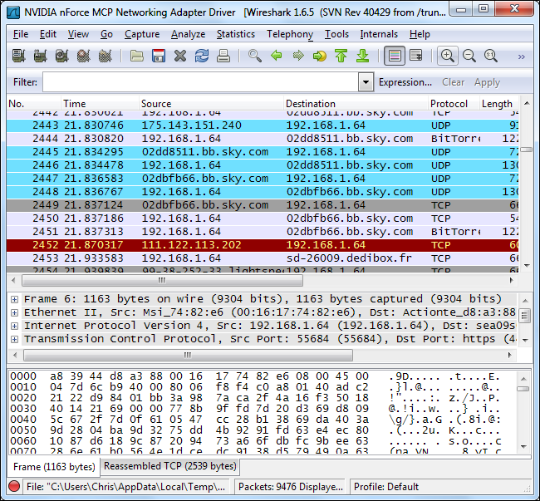
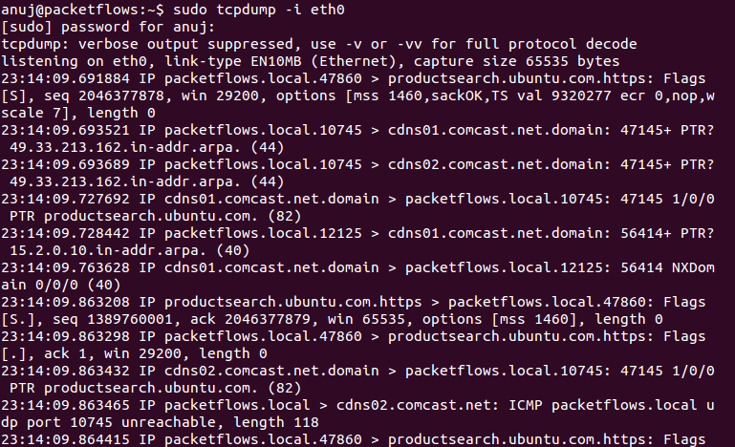
Sniffing
There are a list of tools for sniffing
e.g., Wireshark, tcpdump, Windows Message Analyzer etc.

Slide 10
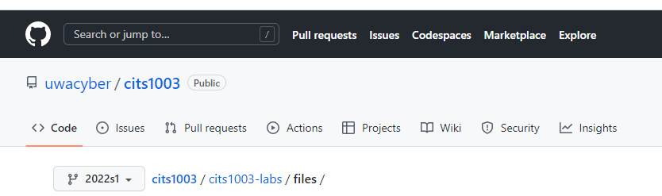
Sniffing
Demo Time: use our VMs
https://github.com/uwacyber/cits1003 password for decryption: infected

Slide 11
Updating
Update sniffex.c with VM’s IP address
Jump to line 553, update the IP address.
IP address command: ip addr show

Slide 12
Compiling
gcc -o sniffex sniffex.c –lpcap
sudo apt-get update
if the error “gcc has no installation candidate” occurs
sudo apt-get install gcc
if “no gcc” is reported
sudo apt-get install libpcap-dev
if the error “pcap.h: No such file or directory compilation terminated” occurs

Slide 13
Sniffing
Is sniffing attack a concern with all the advances in cybersecurity today?
What conditions would make sniffing attacks more likely to succeed?

Slide 14
Sniffing
Is sniffing attack a concern with all the advances in cybersecurity today?
e.g., cloud computing vs IoT
Cloud providers guarantee data security and privacy.
IoT vendors focus more on performance

Slide 15
Sniffing
Is sniffing attack a concern with all the advances in cybersecurity today?
e.g., cloud computing vs IoT
What conditions would make sniffing attacks more likely to succeed?
e.g., a non-encryption or weak-encryption channel

Slide 16
Remote Shell
What is it: remotely execute shell commands on a target computer over the internet.
shell commands, e.g., create/edit/remove files and folders, fetch data, and launch applications
Malicious use: remote shell can be abused by malicious users to cause system damage.
e.g., delete all files on the system

Slide 17
Remote Communication
Demo Time
https://github.com/uwacyber/cits1003

Slide 18
Updating
Update client.c with VM’s IP address
Jump to line 26, update the IP address.
IP address command: ip addr show
For client2.c, repeat the above steps

Slide 19
Remote Communication
README.txt: serves as a basic documentation for a open-source project
Makefile: serves as a script to automatically compile and link a set of source files for the project
To use Makefile, simply run the ‘make’ command.

Slide 20
Compiling
sudo apt-get install make
if the command “make” is not found

Slide 21
Remote Shell
Two types:
Forward shell
The client hacks the server
Reverse shell
The server hacks the client

Slide 22
Forward Shell
Malicious clients can exploit a weakness in their normal connection with the server to gain authorized access to the server.
e.g., we craft a weakness via Dup2() for our demo

Slide 23
Forward Shell
$: a normal user
#: a root user
Demo Time

Slide 24
Forward Shell
In what scenarios forward shell is useful?
What are possible methods we can use to mitigate forward shell?

Slide 25
Forward Shell
In what scenarios forward shell is useful?
e.g., steal/delete/lock sensitive data stored in a high-value server.

Slide 26
Forward Shell
In what scenarios forward shell is useful?
e.g., steal/delete/lock sensitive data stored in a high-value server.
What possible countermeasure can be used to mitigate forward shell?
e.g., regular security patches to software, multi-factor authentication

Slide 27
Reverse Shell
A malicious server lures victim clients (victims) for connection
e.g., we abuse Dup2() for our demo

Slide 28
Reverse Shell
Demo Time

Slide 29
Reverse Shell
Is reverse shell as easy as forward shell? Why?
Can mitigations for forward shell be used for reverse shell? Why?

Slide 30
Reverse Shell
Is reverse shell as easy as forward shell? Why?
e.g., a high-value server might enforce more strict security polices

Slide 31
Reverse Shell
Is reverse shell as easy as forward shell? Why?
e.g., a high-value server might enforce more strict security polices
Can mitigations for forward shell be used for reverse shell? Why?
Yes, e.g., regular security patches to software, multi-factor authentication

Slide 32
Week 2’s Lecture
Key space
Polyalphabetic cipher: 26^n
Monoalphabetic cipher: 26!

Slide 33
Key space
Polyalphabetic cipher: multiple alphabet for substitution
For each letter in a plaintext, there are 26 options.
key space: 26^n (n is the key length)
Monoalphabetic cipher: single alphabet for substitution
For each unique letter in a plaintext, there are 26 options.
key space: 26!

Slide 34
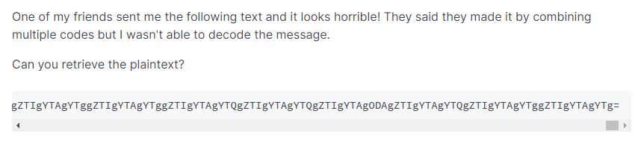
Lab 2
Q5: crypto mess

Slide 35
Lab 2
Hints: 1. figure out the representing code that is used by the text.
What code can generate a text with “=” at the end?
What code can generate a text of numbers 0-10 and letters A-F?
2. figure out the cipher that is used by the text
What cipher can generate a text with dots?
What cipher can generate a text with dots and dashes?

